Slide 1
Drinkworks - Home bar by Keurig
Gestão de Empresas e Empreendedorismo (GEE)
Grupo 2:
Diogo Nunes
Inês Quarteu
João Rocha
João Vítor Fernandes
Miguel Gomes
Rodrigo Reis

Slide 2
Introduction
Question 01
Question 02
Question 03
Question 04
Question 05
A brief introduction to the case study
Is Drinkworks a good product? What problem is it trying to solve? What is its frame of reference?
How do you characterize the target market segment(s) of Drinkworks? What is its potential target market size?
What is Drinkworks value proposition, and what is its positioning in the market? What Pods should be introduced?
How should the device and Pods be priced?
Will Drinkworks be the next billion-dollar opportunity of Keurig and AB InBev? What are the risk opportunities, and what would you recommend Keurig to do to address them?

Slide 3
INTRODUCTION
Drinkworks is the product of a partnership between the home coffee-brewing and soft drink giant KDP (Keurig Dr. Pepper), previously known as Keurig Green Mountain, and the global beer-brewing company AB InBev.
The present case study was conducted by the CEO of Drinkworks and his team to create a home bar device that used “pods” to make instantaneous drinks (either cocktails, beers or cider).
Since the creation of this joint venture, and resorting to previous projects from both companies, Drinkworks started developing this device technology and it now needs to understand its market targets, which kind of pods it will sell and how much these pods and the device itself will cost.
Notes:
Originated from a partnership
KDP (Keurig Dr. Pepper)
Keurig Dr Pepper , formerly Green Mountain Coffee Roasters (1981–2014) and Keurig Green Mountain (2014–2018)
Coffee, tea and hot cocoa
Keurig Kold beverage system, which made single-serve cold beverages (e.g., soda) from pods.
Kold’s sales were lackluster, prompting Keurig to discontinue it in mid-2016
AB InBev (Anheuser-Busch InBev)
AB InBev was formed through InBev (itself a merger between Interbrew from Belgium and AmBev from Brazil) acquiring Anheuser-Busch from the United States
Sold more than 500 different beer brands in more than 100 countries.
Researching the market opportunity for a home appliance
Drinkworks Home Bar: New home appliance and pod system for chilled alcoholic beverages.

Slide 4
Question 01
Novel idea
Short time to master
Easy to use
Premium product
Is Drinkworks a good product? What problem is it trying to solve? What is its frame of reference?
Solves a niche problem
Undefined market size
Unclear target consumers
Ambiguous profit margins
Overall, Drinkworks is a good product, its quality, design, convenience, ease of learning and usage are attractive for consumers. It has many attributes of a successful product.
It lacks some elements that could impact its profitability, mainly due to being a idea in a relatively new and niche market without previous concrete data and statistics about prices and sales.
Notes:
There are several elements and attributes which are indicators on whether a product is good or not.
By examining these factors we can better predict if a product is going to be successful, the main goal being making a profit for the company.
The amount of direct competition a product has can have a big impact on its prosperity.
Drinkworks distinguishes itself by being one of the first companies to start operating on a market that still doesn’t have any established top companies.
The idea of a home appliance and pod system for chilled alcoholic beverage is new, especially with the pods with alcohol included.
It’s an innovative idea which can sometimes be negative if the consumers don’t understand it, however the product was designed to be easy to understand and easy to use.
This accompanied with the overall construction design transmits a sense of quality and design representative of a premium product
A good product should also solve a problem, Drinkworks does this of course, however it is a very specific problem.
People aren’t actively looking for a solution to make cocktail consumption at home more accessible.
The market size and target consumers are also very hard to predict since there is no data about prices or sales of similar products.
It is a fundamental need that a product makes a profit otherwise it will just inflict financial damage on the company.
Other types of research need to be made such as studies and inquiries on potential consumers which may or not reflect the actual outcome of events after the product’s launch.

Slide 5
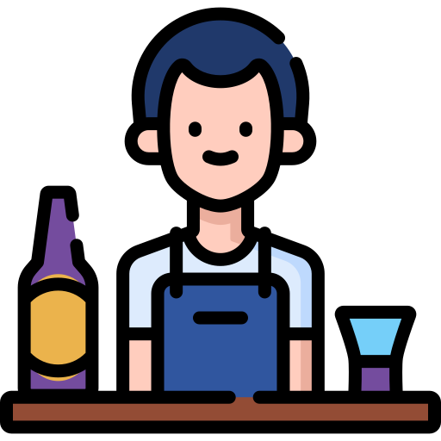
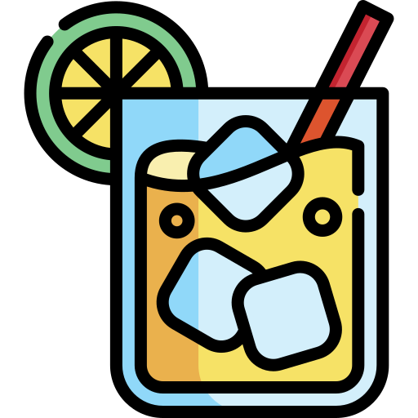

Question 01: [Problem] At-home cocktail consumption
Skill
Ingredients
time
In order to make a good cocktail you need cocktail making skills. This may prevent people unfamiliar with the process from making a cocktail at home.
There are many ingredients needed for making a cocktail which vary depending on the type of cocktail.
Making a cocktail takes considerably longer compared to other beverages.
Notes:
The problem that Drinkworks is trying to solve is that people very rarely consume cocktails at home.
However, this is not due to them not wanting it statistics from surveys indicate that people do consume cocktails more frequently outside of the home.
This follows the opposite trend of other alcoholic beverages, which are consumed more often at home.
Cocktails are on the exquisite side of alcoholic beverages.
They require lots of ingredients, especially if you want to make different types of cocktails.
Time is also a crucial part of whether someone is going to do anything regularly, cocktails take a long time to make relative to other beverages.
On top of all of this, even if you have the ingredients and time to make a cocktail, you still need to know how to do so.
For example, most people don’t cook meals at home which require lots of ingredients and time to make regularly, they go out to restaurants.
Drinkworks solves all this with a quick and easy to use the home appliance, enabling you to make cocktails fast, efficiently and comfortably.
Historically social gatherings and parties at home come hand-in-hand with alcohol consumption, hosts are many times preoccupied with providing a large variety of drinks.
Drinkwork’s pod system solves that problem with pods that are portable and easy to keep in store.

Slide 6
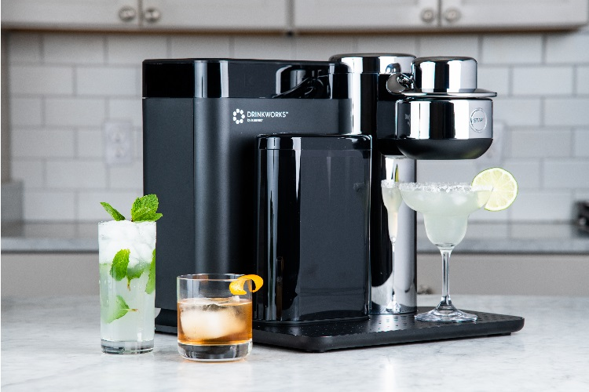
Question 01: Frame of reference
The frame of reference for the Drinkworks’ product is Cocktail Consumption at home.
Within this frame of reference, Drinkworks will have to compete with other companies that although operating in the same market, present a different product concept. Amongst these the following stand out:
Ready-To-Drink (RTD) cocktails in cans or bottles;
Cocktail-making kits: cocktail recipes, alcohol, mixers and ingredients;
Cocktail-themed subscription boxes (without alcohol);
Devices with mixer pods;
Notes:
Some competitors in similar markets that Drinkworks has are:
RTD cocktails in cans or bottles (companies like Cardinal Spirits and St. Agrestis)
Monthly or in demand:
Cocktail kits - cocktail recipes, alcohol, mixers and ingredients (companies like Cocktail Courier, Saloonbox)
Subscription boxes - without alcohol (Shaker & Spoon)
Direct competitors looking to enter the home appliances for cocktails market (Bartesian)

Slide 7
Question 02
Drinkworks home bar intends to offer a simple way of producing a large variety of drinks and therefore it is a product that should target people who consume alcoholic beverages with some regularity and probably have a habit of hosting others.
Drinkworks market research led them to identify the target market for their product and divide it into 6 well-defined groups of potential target customer profiles, based on:
Alcohol consumption;
Hosting frequency;
Age;
Keurig device ownership;
How do you characterize the target market segment(s) of Drinkworks? What is its potential target market size?
Notes:
For that, they made some studies and analyses:
An online survey in 2017
Approximately 1800 individuals between 25 and 64 who had consumed alcohol in the last four weeks (59% of US households)
Survey asked about their frequency of alcohol consumption and their interest in a potential drink-making appliance
The target market can be divided into 6 groups. The three most important represent 44% of the households
Target Customer Profiles
Young people that drink and host frequently (21%)
Older people that drink and host frequently (13%)
Middle-aged people that concerned about alcohol quality (10%)
People that rarely host at home but would use a machine for cocktails on special occasions (12%)
Social infrequent spirit drinkers (17%)
Non-social infrequent drinkers (27%)

Slide 8



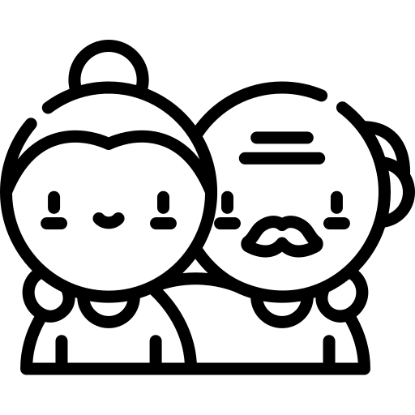

Question 02: Target market segments
Weekly Younger Drinkers and Hosts
Weekly older drinkers and hosts
Monthly drinkers and hosts
Demographic
psychographic
Age; Gender; Income
Lifestyle: living alone or together; Interests: hosting, alcoholic/non-alcoholic/spirit drinkers, drinking in general
Young customers want to be able to mix products easily and cheaply, either hosting or drinking alone. Drinkworks offers a variety of beverages, being more affordable and more convenient amongst competition.
Older customers also want to mix different products and being prepared to offer different drinks depending on people’s preferences (convenience).
These customers want to offer high-quality drinks to their guests when they are hosting. Drinkworks offers that high-quality service pretended combined with affordability, variety and convenience.
Notes:
The target market can be categorized into 6 different categories. Of these, the 3 largest customers are: weekly young drinkers; weekly old drinkers; monthly drinkers/hosts
For each of these groups, Drinkworks presented a different solution.
Based on the target customer profiles given by the online survey, we can easily identify some variables of segmentation:
(1st part of the slide)
With this, we can match the target market segments that Drinkworks should focus on, which are also the 3 groups with a higher percentage that would invest in a product priced at $199 and pods priced at $4.
(2nd part of the slide)
In summary: Drinkworks aims to create an affordable, high-quality solution for beverages, that can be prepared in a convenient way, and a large number of different ways, incentivizing to mix different products.

Slide 9
Question 02: market target size
325 100 000
59%
44%
84 395 960
US Citizens in 2017
of US households consume alcohol monthly
of target market belong to the identified segments
Potential customer in target market
Notes:
For that, they made some studies and analyses:
An online survey in 2017
Approximately 1800 individuals between 25 and 64 who had consumed alcohol in the last four weeks (59% of US households)
Survey asked about their frequency of alcohol consumption and their interest in a potential drink-making appliance
The target market can be divided into 6 groups. The three most important represent 44% of the households
59% of households in the US consumed alcohol at least once, in the last month. Of these, 44% belong to the three groups with the largest intention to purchase a product. Thus, the size of the most important market segment is 85 530 000 (329500000*0,44*0,59), corresponding to 26.0%.
Weekly Younger Drinkers and Hosts: 40 279 890
Weekly Older Drinkers and Hosts: 24 935 170
Monthly Drinkers and Hosts: 19 180 900

Slide 10
Question 03
The main value proposition that would distinguish Drinkworks from the other players in the market is convenience. The expected convenience is mainly due to the addressing of the problem previously identified, given that:
the customer now has access to many alcoholic beverages choices, provided that they have a wide range of pods;
the time needed to make a cocktail would decrease to be less than a minute for drinks such as a Manhattan, margarita or Moscow mule;
there is no need for the customer to have any prior skills.
Additionally, Drinkworks' value proposition also includes the products high technology, overall quality, and affordable options for the younger audience.
What is Drinkworks value proposition, and what is its positioning in the market? What Pods should be introduced?

Slide 11
Question 03: Market Positioning
Among people that drink or host frequently, Drinkworks is the brand of cocktail consumption at home that provides a high variety of quality alcoholic and non-alcoholic drinks at the simple touch of a button through a very convenient all-in-one compact drink pod. Market research shows that Drinkworks evokes happiness, excitement and relaxation, which impacts positively on the consumers.
Notes:
The main aspects that set Drinkworks apart from these other companies and products are:
Variety - Different types of pods
Simplicity - On-the-go cocktails, are faster to make than other
Compactness and Convenience - Pods are easy to store, lightweight and compact enough to store
Party hosting - Provides a solution for party hosts
Innovative - New ideas and technologies that allow the product to be developed

Slide 12
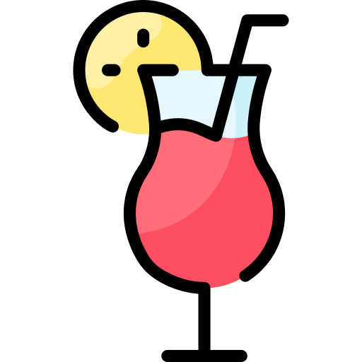

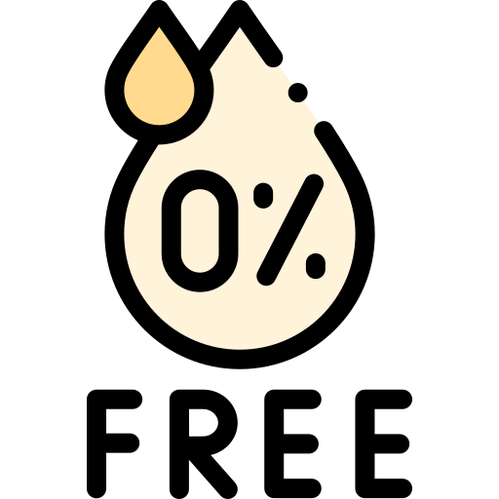
Question 3: Pods to introduce
This table presents the manufacturing costs and the minimum interval of selling prices necessary to cover these costs, in liquor stores, traditional retail stores and e-commerce, respectively, for each type of pod.
Even though they present the lowest price, to break even, the non-alcoholic mixer pods have to be priced at a higher price than $1.00, which doesn’t seem to be very desirable for the potential customers.
More than half of the enquired population admitted being willing to pay $3.00 and $2.00 for the alcoholic cocktail pods and beer/cider pods, respectively, which would mean the company, would, most likely, be able to profit from these.
1.20 | 0.95 | 1.10
2.10 - 2.61 | 1.58 - 1.94 | 1.93 - 2.40
— | 1.27 - 1.46 | —
1.41 - 1.60 * | 1.12 - 1.27 * | 1.29 - 1.47 *
* This price has another expenses associated not accounted for
Notes:
This table presents the manufacturing costs and minimum interval of selling prices necessary to cover these costs, in liquor stores, traditional retail stores and e-commerce, in that order, for each type of pod.
To calculate the interval of prices registered in each row the following was taken into account:
in liquor stores, wholesalers take a margin of 20% to 25% on wholesale selling price, and retail stores expected a margin of 25% to 35% on retail selling price. Drinkworks would also have to pay a spirits excise tax of around $0.10 to $0.15 per pod.
in traditional retail stores, retailers’ margins typically ranged from 25% to 35%, and they can not sell alcoholic beverages.
in e-commerce, margins for e-commerce channels are Amazon were 15% to 25%.
The calculation derived from this information is presented in the excel spreadsheet submitted alongside this presentation.
The willingness to pay for each pod is as follows:
for cocktail pods, 51.5%, 57.4% and 72.8% are willing to pay $4.00, $3.00 and $2.00 for a pod, respectively;
for non-alcoholic mixer pods, 72.7% of potential customers are willing to pay $1.00 and 31.8%, $2.00;
for beer/cider pods, 55.1% are willing to pay $1.00 and 51.7% are willing to pay $2.00

Slide 13
Question 3: Pods to introduce
Cocktail Pods
pros
cons
Financially more viable;
Potential customers seem moderately interested in the product;
Would not need to purchase alcohol separately;
Cocktail pods are the most appropriate for targeting the previously identified market segments;
Needs to deal with US’s heavy alcohol regulation for distribution;
Non-alcoholic mixer pods seem to be easier for consumers to comprehend;
Consumers seem skeptical that they won't be able to enjoy their favourite brands of alcoholic beverages;
It may be the most expensive option for the end consumer;
Beer/CIder Pods

Slide 14
Question 04
In order, to answer Question 04 it is necessary to first resolve the following issues:
What products people are willing to pay more comparing to real cost to manufacture, distribute, accounting for returns, warranty replacements, promotions, fulfillment and freight.?
Should the willing to pay or the profit tax dictate the product price?
Is it better to profit from the Home Bar or the pods?
What should be considered to price the products?
How should the device and Pods be priced?

Slide 15
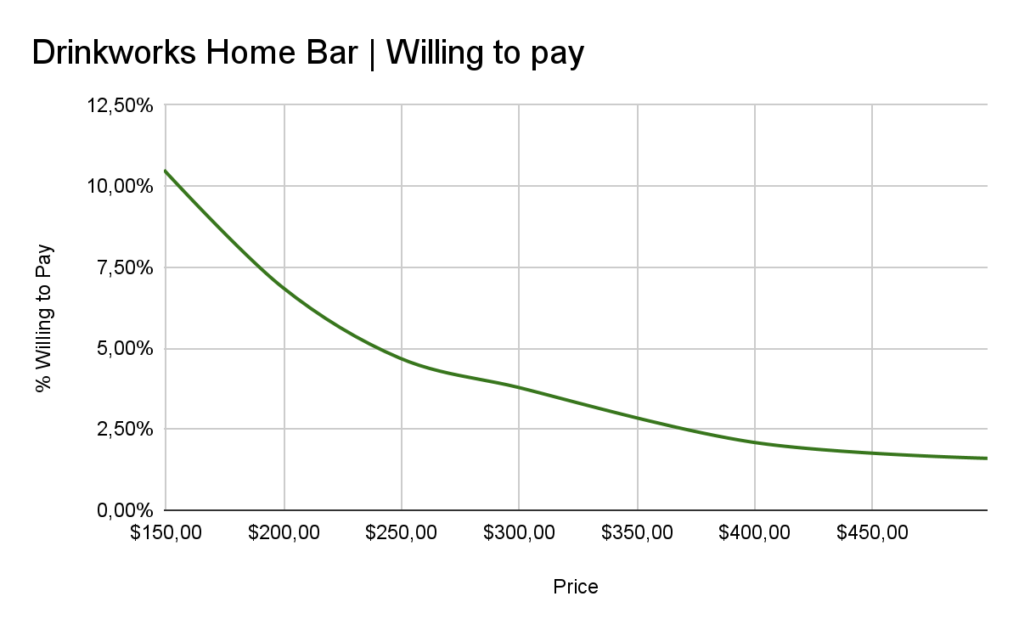
Question 4: PRICE OF DRINKWORKS HOME BAR
The price need to be greater than $250, because it is the cost approximately to manufacture and distribute it.
With a price of $299 we expect that approximately 25% of the people that are willing to pay for the machine could buy it.
With a price of $279 we expect by linear interpolation that approximately 32.5% of the people that are willing to pay could buy it, with a 10% of profit.

Slide 16
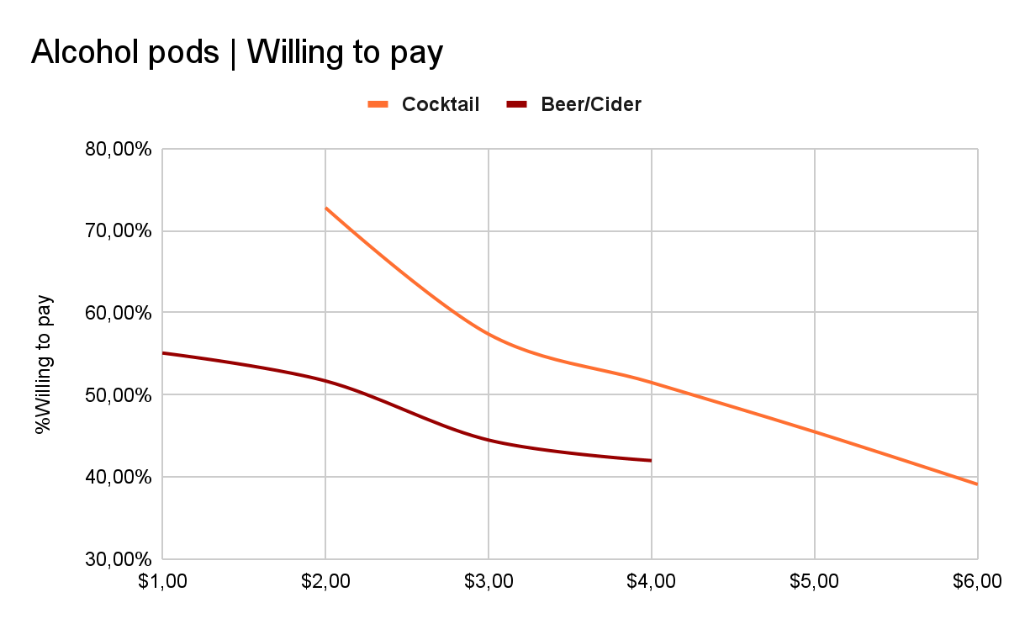
Question 4: PRICE OF alcohol pods
The price of cocktail pods need to be greater than $2.61, because it is the max cost to manufacture and distribute it.
With a price of $3.99 we expect that approximately 51.50% of the people that are willing to pay for a cocktail pod. (~35% profit).
The price of beer/cider pods need to be greater than $2.40, because it is the max cost to manufacture and distribute it.
With a price of $2.99 we expect that approximately 42% of the people that are willing to pay for a cocktail pod. (~20% profit).
People are willing to pay more for alcoholic drinks.

Slide 17
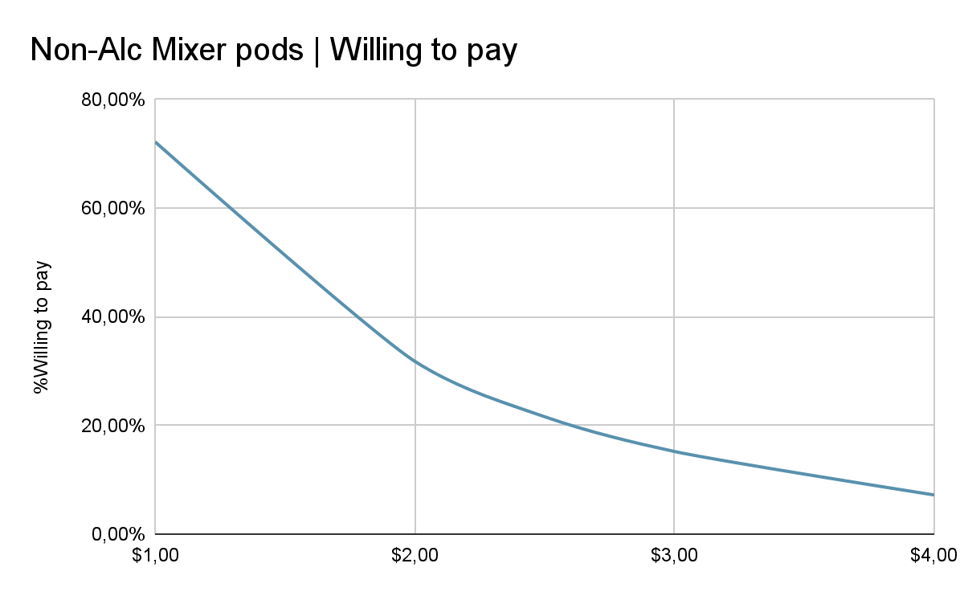
Question 4: PRICE OF mixer pods
The price need to be greater than $1.94, because it is the max cost to manufacture and distribute it.
With a price of $4 we expect that approximately 51.50% of the people that are willing to pay for a cocktail pod. (~65% profit).
People are willing to pay more for alcoholic drinks.

Slide 18
Our prices and conclusions
Description | Profit | Our Price
Drinkworks Home Bar | ~10% | $279,99
Cocktail pods | [~35%, ~45%] | $3.99
Beer/Cider pods | [~19.7%, ~35%] | $2.99
Non-alcohol Mixer pods | [~2.5%, ~21%] | $1.99
People are willing to pay more for the alcohol pods that the non-alcohol pods.
People are willing to pay more for the alcohol pods that the Drinkworks Home Bar.
Notes:
We use prices that end with …99.99€ because for the consumer it creates the illusion that is a more reasonable price.

Slide 19
Question 05
Drinkworks is a novel product idea but there are justifiable concerns involving the predicted difficulty that the distribution of alcoholic pods will impose.
The profit margin of the selling of machines and pods is not predicted to be very large. Drinkworks has no direct competitors and while it is apparent that the market is not as big as they expected, it may still have a decent enough potential.
The weekly attachment rate initially fell off, but it is projected that it converges to a rate 6 or 5 weekly attachments. This would mean that there is a ongoing use of the product, as it is not expected to wear off after the initial contact with it.
While there is no way to assure that Drinkworks will be the next billion dollar opportunity for Keurig and AB InBev, it seems that this joint venture has a promising future.
Will Drinkworks be the next billion-dollar opportunity of Keurig and AB InBev? What are the risk opportunities, and what would you recommend Keurig to do to address them?

Slide 20
Question 5: risk opportunities and how to address them
Many risk opportunities should, at least, be kept in mind, because sometimes the world’s dynamic changes and an idea that doesn’t work today, might be an opportunity to consider tomorrow.
Some chances worth keeping in mind are:
Expand the market to the rest of the world: analyze trends and preferences and focus on a certain type of pods for a certain region;
Somehow reduce overall costs, so we can sell at a lower price and still have a decent margin profit;
Search for new variants so they can reach new target market segments, like baby bottles, energy drinks and smoothies;
Rechargeable and portable devices, so people can use them outside;
Biodegradable pods, in an era where all these issues are always kept in mind;
Join well-known and well-established companies from different contexts to expand their content faster and efficiently;
Possibility to save customers’ preferences and interconnect people with similar habits (for example, where a certain beer pod consumer can talk with one another);
Monthly/Yearly giveaways to consumers that bought some device and/or pods.
Notes:
Keurig has opportunity to enter in the market quickly then they can come with smaller and cheaper brewers.
Keurig has opportunity to enter in the retail market in future due to the less overall costs.

Slide 21
THANKS!
Does anyone have any questions?

